Slide 1

An introduction to co-production in Staffordshire
Notes:
The slide deck is intended to help you and your team to explore co-production as a way of working, to grow in our understanding of co-production, to be aware of the available tools that could help and begin to understand how it could help to improve our working practice and outcomes for those we are responsible for providing support for.
The notes for each slide will support the slide content and you do not need to be experts to lead or engage in this exercise.
It could be used as an agenda item on a team meeting with a number of options available.
1) 10-15 minute slot - Covering a brief introduction and playing the co-production promise video (link embedded).
2) 45 minutes As option 1, followed by watching/discussing the 2 short 10-minute webinars that help grow our understanding of co-production.
3) As option 2, plus the full interactive exercise outlined on slide 5, where our team is able to consider how and when we might use co-production to make things better for those we are responsible for providing services for by more fully involving them at every stage.

Slide 2
The journey so far
2022 - The need for a Co-production Charter or Promise was identified
2022-23 – Co-production Promise content co-produced with Children, Young People, Parents, Carers and Professionals, and a Workforce Toolkit created to support practice.
2023 – Co-production Promise signed off by Staffordshire’s Health and Wellbeing Board, ICS Children and Young People’s Programme Board, Violence Reduction Alliance, Communities Leadership Group, Safeguarding Partnership, Early Help Partnership Board.
2024 – Process of embedding commitments through culture change and frontline practice begins
Notes:
Statutory Guidance
The SEND Code of Practice from 1 September 2014 Government guidance on special educational needs and disability (SEND) for children and young people aged 0 to 25 years.
Co-production and the Care Act - https://www.thinklocalactpersonal.org.uk/co-production-in-commissioning-tool/co-production/In-more-detail/co-production-and-the-Care-Act/
NHS Statutory Guidance on working with people and communities:
https://www.england.nhs.uk/long-read/working-in-partnership-with-people-and-communities-statutory-guidance/
Initially the local need for a co-production charter/promise was identified in the CYP SEND system following an OFSTED inspection, however was quickly expanded to cover the whole CYP System and subsequently also adopted by Adult Social Care.
The Co-production Promise commitments resonate with existing strategies such as the SEND and Early Help. It also resonates with Relational and Restorative Practice principles, Child First principles, strength-based models, etc.

Slide 3
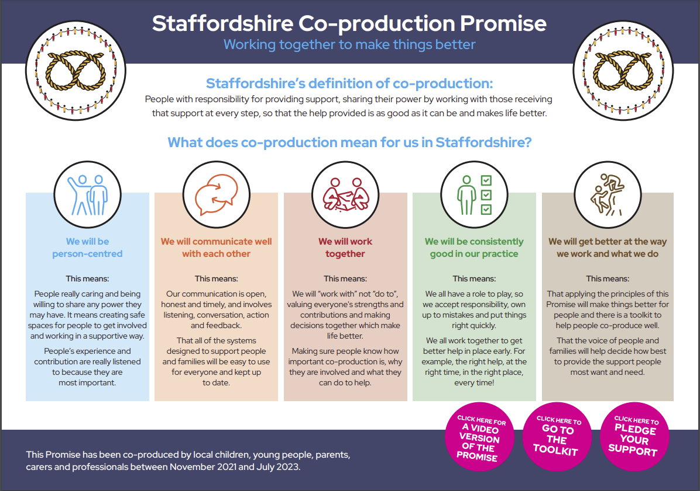
The
Co-production Promise
Watch this short video that introduces the Promise -
Notes:
Here is the final document launched in October 2023 at the Together We Thrive Event at Staffordshire showground.
Play the video via the YouTube link to hear the story so far and to introduce the content.

Slide 4
More information and tools
Downloadable Co-production Toolkit
Short webinars to grow your teams understanding of co-production
Starting a conversation around Co-production
Co-production in the wider context of engagement
One Stop Shop for Co-production Resources
Notes:
Here are some freely available tools to support the workforce to adopt co-production as an approach in some or all their practice.
The toolkit is a comprehensive document outlining what co-production is and isn’t, why we should do it, when to use it as an appropriate approach as well as when not to.
It includes checklists, do and don’ts, identifies common challenges and lessons learned and gives examples as to how the Promise can be used by different parts of the system.
2 short 10-minute webinars have been created. One to introduce co-production to the local workforce and two to place co-production in the wider context of consultation and engagement.
Alternatively, here is a link to a video from TLAP which tries to explain the different rungs of the ladder of engagement in an adult social care context - https://youtu.be/kEgsJXLo7M8
We have also gathered useful information and resources around co-production in a one stop shop called a Padlet. This is like an online notice board, where we put anything and everything related to co-production that might be of use or interest to the workforce.
We have tried to organize it in relation to Stoke-on-Trent and Staffordshire resources / local training and support for the workforce (toolkits, webinars, etc.) / case studies and impact / resources and tools from elsewhere.

Slide 5
Committing to co-production
Enter your team’s actions/ pledges here
Enter your team’s actions/ pledges here
Enter your team’s actions/ pledges here
Enter your team’s actions/ pledges here
Enter your team’s actions/ pledges here
Notes:
In this exercise, we as a team will look at the 5 commitments included in the Promise document. (There is a little more detail around each of these commitments on the Promise document to help identify specific areas of potential improvement or areas we can co-produce together.)
Remember these commitments are not just about how your own team works together (teamwork). They should include the way we work with other professionals across the system (partnership and collaboration), and also how we share power with those who receive the support we are responsible for providing (co-production). Our responsibility can be for frontline practice, design and commissioning of services, strategic leadership or as an accountable elected member. See the Co-production toolkit for further support to identify your actions
Embedding these commitments is about culture change, improved practice and better ways of working.
Co-production is a gold standard and therefore can seem daunting and impossible to achieve. Aiming for co-production as an aspiration will help your team make positive progress up the Engagement Ladder (see toolkit page 5 and 6) and webinar for more information), and it is worth remembering, failing (if it brings learning) is still an outcome.
In other words, if we aim for the stars and reach the moon, that is better than aiming for the moon and not getting out of orbit.

Slide 6
What are the potential enablers / barriers for our pledges?
Enablers
Barriers
Notes:
What is available that can help us as a team embed your pledged actions? What is already there to help us as a team? What assets or strengths (policies, practices, ways of working, etc.) can we build from?
What are the barriers? These might be ways of working, policies and practices, resources, timescales,
See page 9 of the toolkit for support

Slide 7
Thanks for using this workforce development tool.
Do let us know how you got on and any suggested improvements or additions.
Contact Phil Pusey – phil@staffscvys.org.uk
Notes:
The slide deck is intended to help you and your team to explore co-production as a way of working, to grow in your understanding of co-production, to be aware of the available tools that could help and begin to understand how it could help to improve your working practice and outcomes for those you are responsible for providing support for.
If you have any follow up questions, please do contact Phil and he will do his best to help with responses.
If you would like to suggest improvements or additions to these slides, contact Phil via the email address on the slide above.
Equally, if your team found this approach useful, and would like to share what you are going to do differently moving forwards, we would love to hear about that too.

